Slide 1

BRITISH AIRWAY
Predicting customer buying behavior
07/06/2023

Slide 2
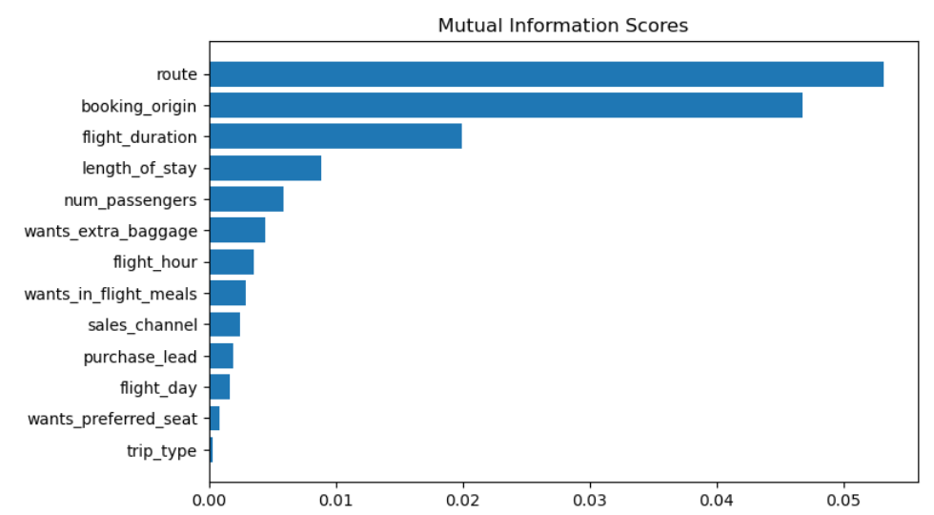
predictive model to understand factors that influence buying behavior
We have trained the data set with Random forest classifier model and received:
ACCURACY: 85.09
AUC score: 0.5577796717361984
route
booking_origin
flight_duration
wants_extra_baggage
length_of_stay
are the top 5 features which influence Customer buying behavior
We need to increase the AUC score.

